Slide 1
Loading….

Slide 2




Slide 3
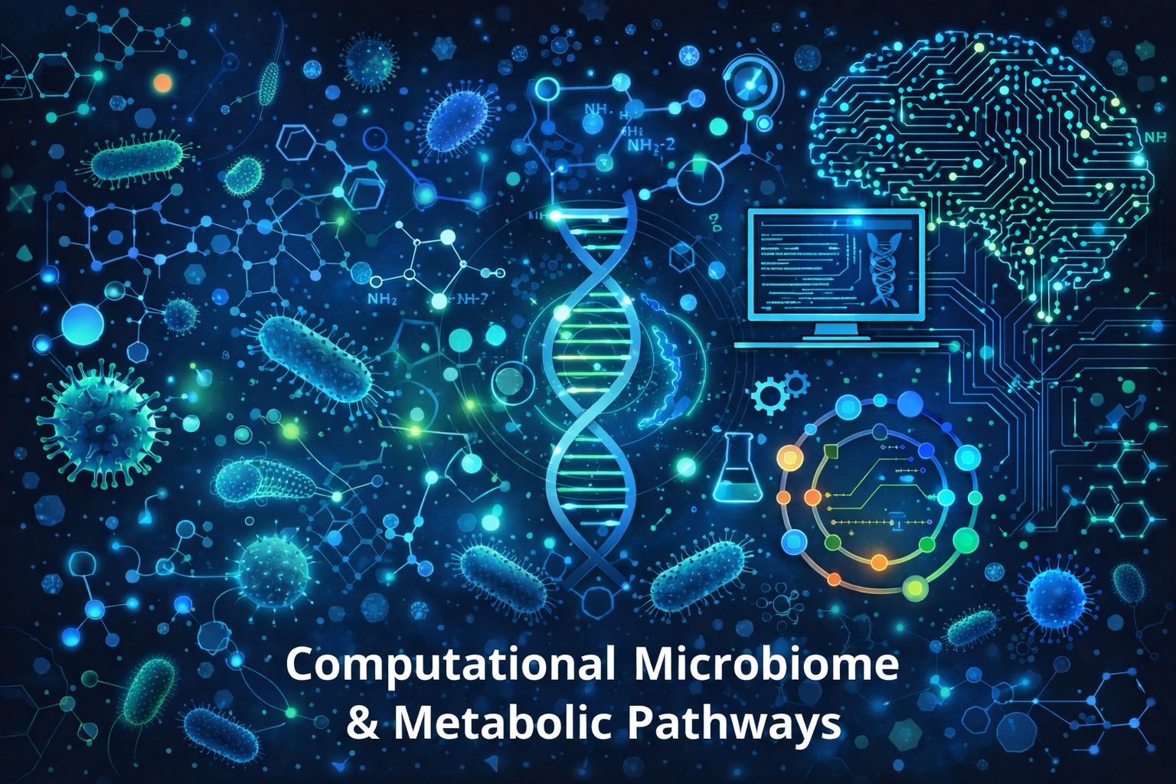

Slide 4

Introduction
History
The most widely used areas in bioinformatics
Applications of Bioinformatics
Computational microbiome
The microbiome consists of 4 important layers
What is a Metabolic Pathway
Tools used in computational bioinformatics Validation
Benefits / Disadvantages / Challenge
Future vision
Article

Slide 5


Introduction
As more genomes are fully sequenced, analyzing genomic data has become crucial in modern biology. This demand led to the development of bioinformatics, which applies computational tools to store, organize, and interpret biological information. The term, introduced by Paulien Hogeweg and Ben Hesper, originally described the study of information processes in living systems and emerged with the early sharing of biological sequence data.
Although the term “bioinformatics” has been part of the scientific lexicon for only two decades or so, when the origins of many bioinformatics concepts are carefully investigated, we learn that the underlying principles of bioinformatics come from early studies that combined computational and experimental approaches in molecular and cell biology.
A
B
C
start
1
2
3
4
5
6
7
7
https://doi.org/10.1016/bs.mim.2017.08.002

Slide 6
Introduction
With the advancement of powerful methodologies in molecular, structural, and chemical biology, such as genome-scale sequencing, microarray gene expression analysis interference (RNAi), high-throughput crystallization and more, all of which produce massive amounts of biological data, it has become obvious that “biological information processing” is as important as data production, and merits becoming a separate discipline with its own customs.
Bioinformatics is an interdisciplinary field that combines biology, computer science, and mathematics to analyze and interpret large amounts of biological data. With advances in laboratory technologies, such as DNA and RNA sequencing, the volume of data has grown to such an extent that it is no longer possible to analyze it without computational methods.
A
B
C
start
1
2
3
4
5
6
7
7

Slide 7
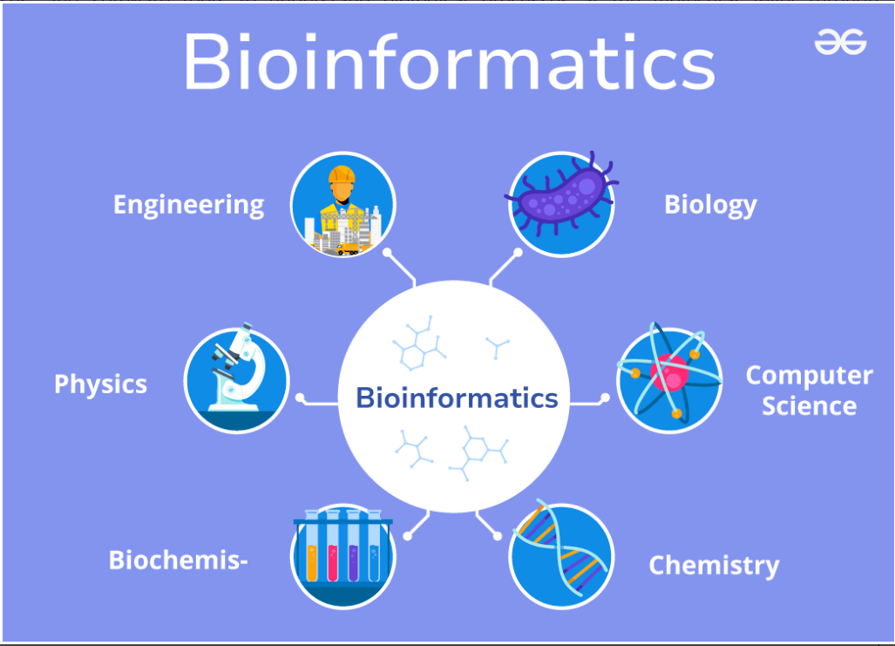
A
B
C
start
1
2
3
4
5
6
7
7

Slide 8
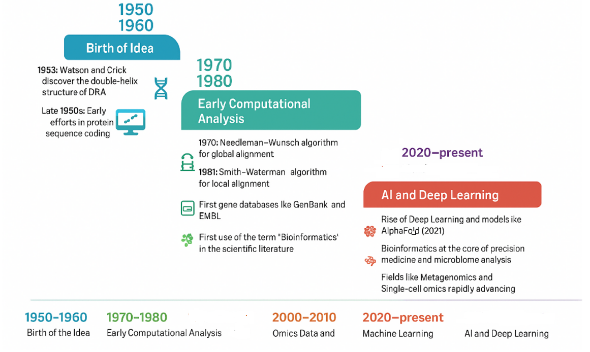
History
A
B
C
start
1
2
3
4
5
6
7
7

Slide 9
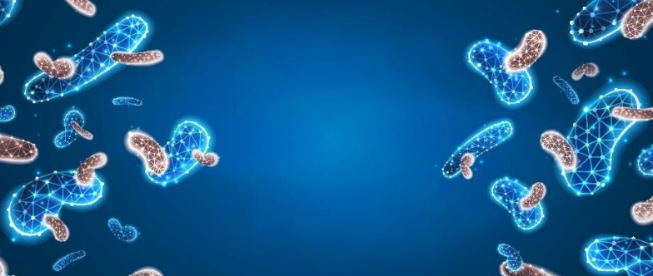
The most widely used areas in bioinformatics
There are several very widely used areas in bioinformatics that are most widely used in medical research. Below, I will briefly and practically explain the most important of them.
A
B
C
start
1
2
3
4
5
6
7
7

Slide 10
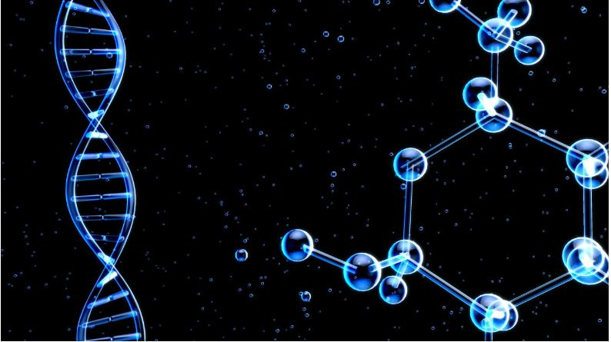
Genomics
Analysis of DNA and genome data
Transcriptomics
Analysis of RNA gene expression
Proteomics
Analysis of protein structure and function
Metabolomics
Analysis of cellular metabolites
Structural Bioinformatics
Study of the 3D structure of proteins
Microbiome Bioinformatics
Drug / Pharmaco informatics
A
B
C
start
1
2
3
4
5
6
7
8

Slide 11
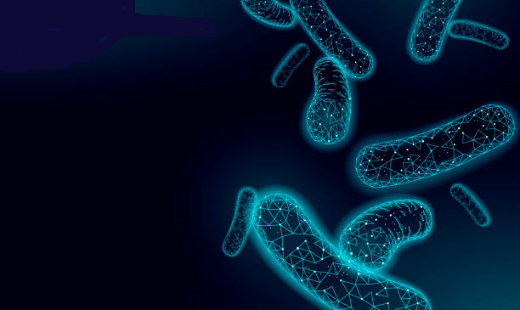
Applications of Bioinformatics
Extensive use in structural, functional, and nutritional genomics
Proteomics analysis: protein identification, protein structure, protein–protein interactions, and post-translational modifications
Transcriptome analysis to measure gene (mRNA) expression levels
Use of cheminformatics methods: similarity searching, clustering, QSAR modeling, virtual screening
Effective tools for prediction, analysis, and interpretation of clinical and preclinical data
A
B
C
start
1
2
3
4
5
6
7
8

Slide 12
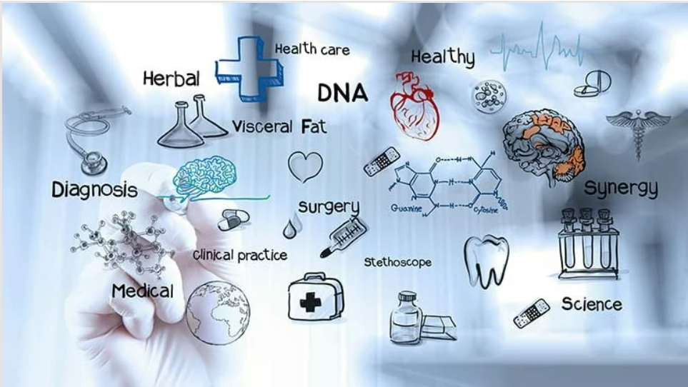
Its major applications in other fields include:
Molecular medicine
Personalised medicine
Preventative medicine
Gene therapy
Drug development
Microbial genome applications
Biotechnology
4
5
6
7
8
9
10
11
12
6
7
8

Slide 13

Computational microbiome

Slide 14
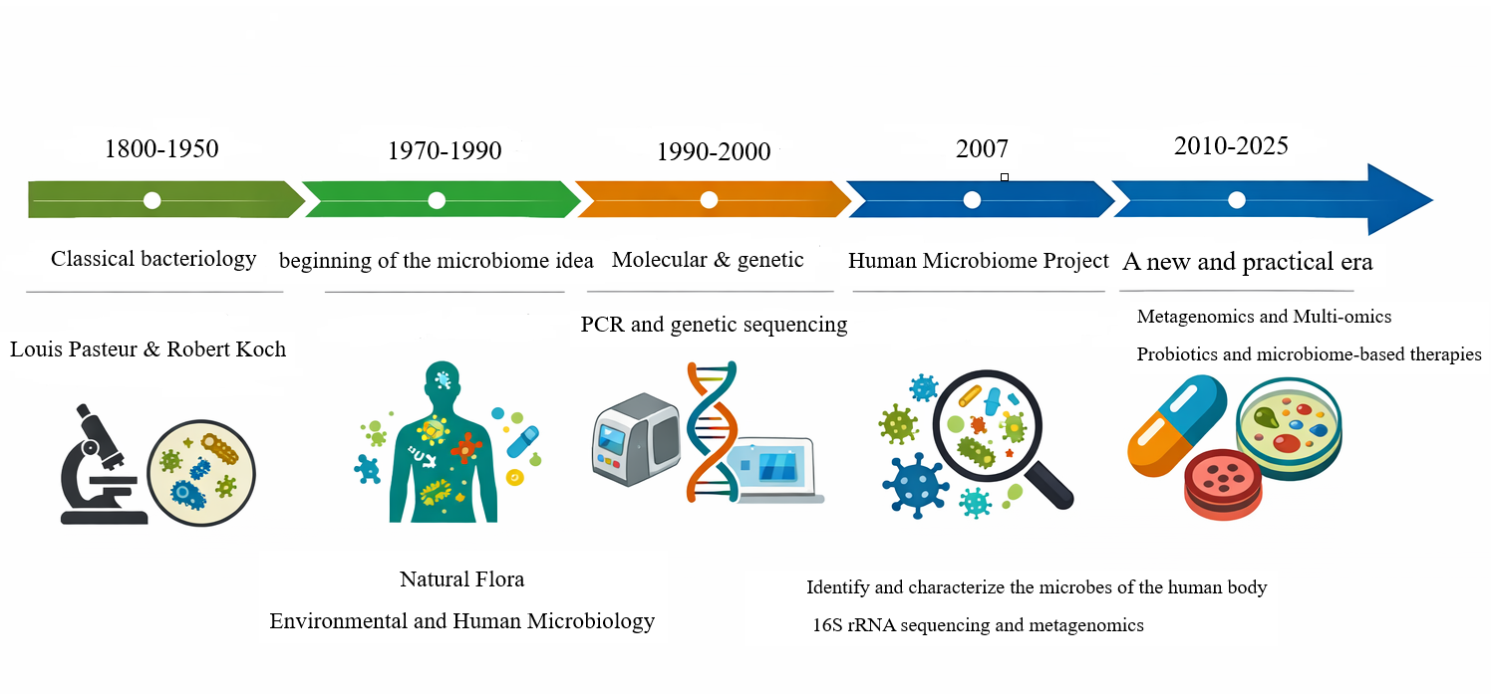

4
5
6
7
8
9
10
end
12
6
7
8

Slide 15
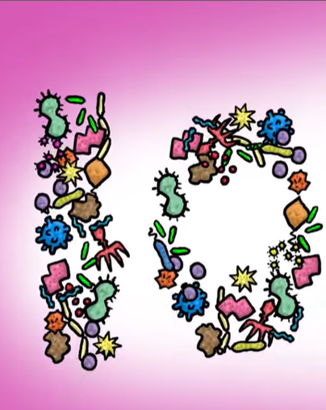
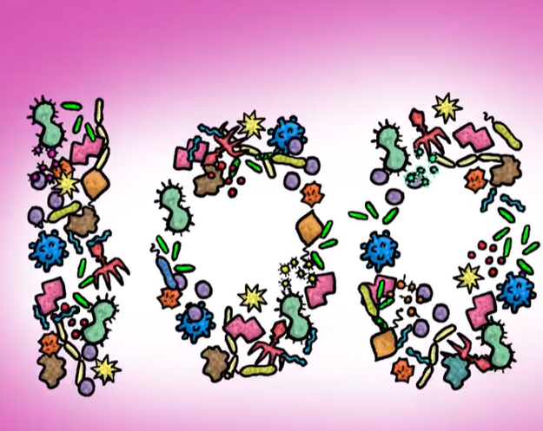
Microbiome
The microbiome is the integrated collection of microorganisms, along with all their genes, genetic material, metabolic pathways, chemical products, interactions, and the environment in which they live. This definition includes both living organisms and their "genetic and functional information."
4
5
6
7
8
9
10
11
6
7
8
Notes:
حدود ۱۰ تا ۱۰۰ تریلیون میکروب زندگی می‌کنند که تعداد آن‌ها می‌تواند چندین برابر سلول‌های بدن خود انسان باشد و در یک فرد بالغ حدود ۰.۶ تا ۱.۸ کیلوگرم میکروب زندگی می‌کند

Slide 16
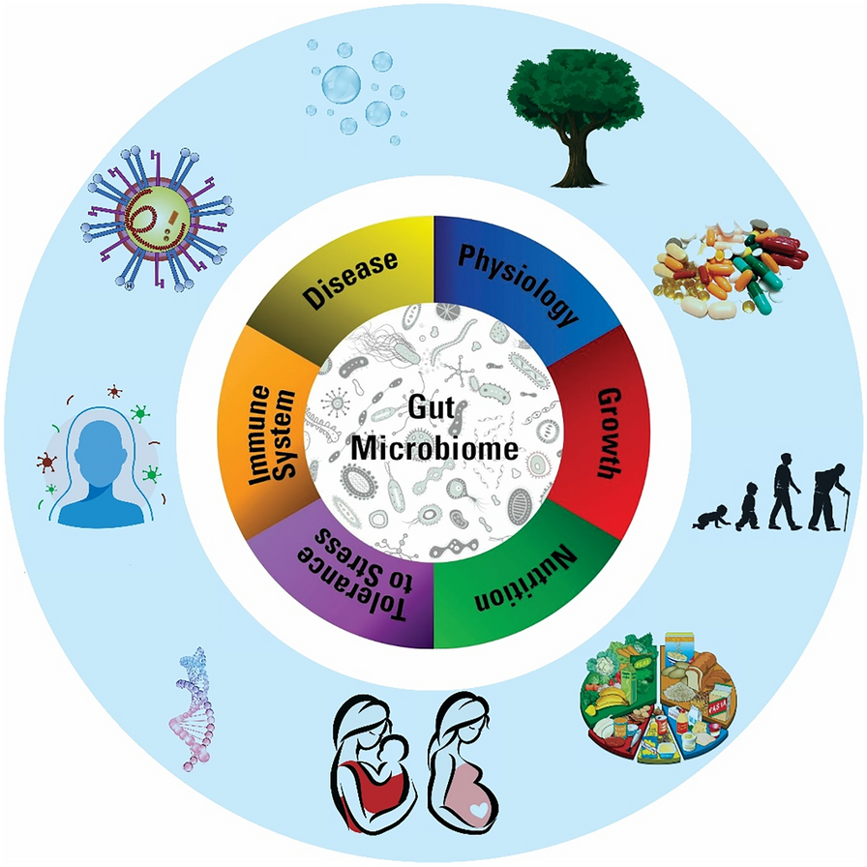
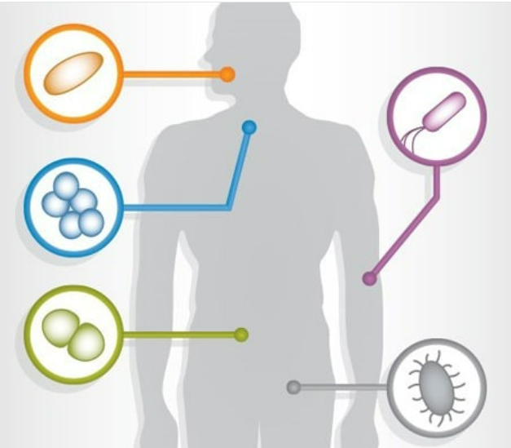
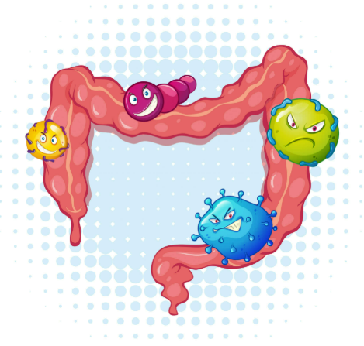
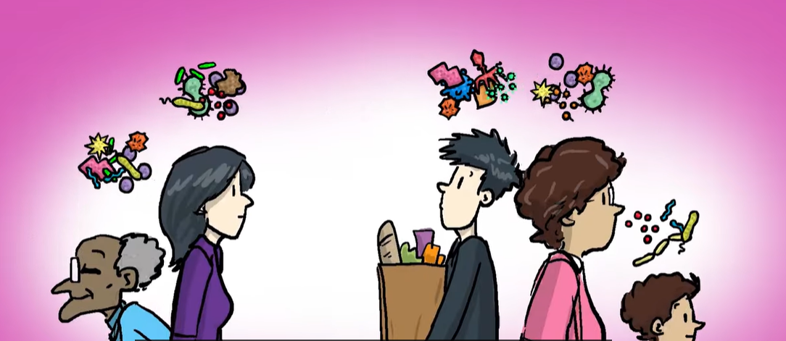
4
5
6
8
9
10
11
12
13
6
7
8

Slide 17
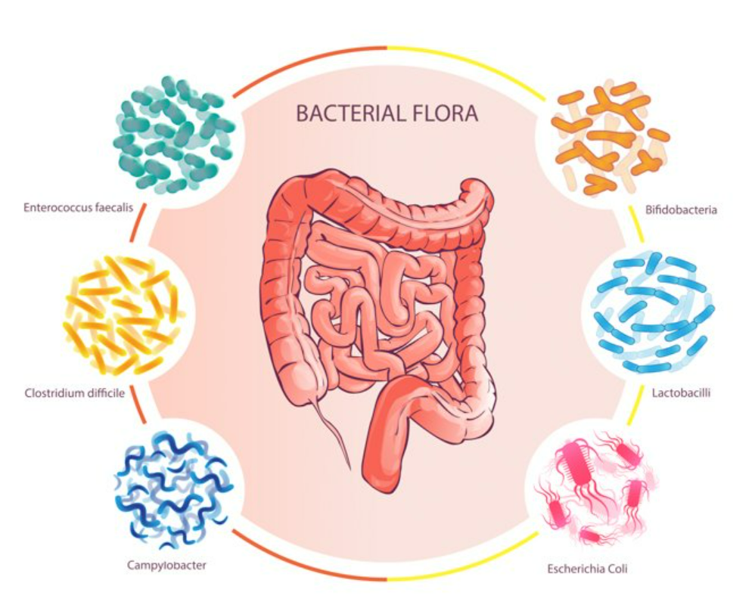
Bacteroides fragilis
Bacteroides melanogenicus
Bacteroides oralis
Enterococcus faecalis
Escherichia coli
Genus Enterobacter
Genus Klebsiella
Bifidobacterium bifidum
Staphylococcus aureus
Lactobacillus
Clostridium perfringens
Proteus mirabilis
Clostridium tetani
Clostridium septicum
Pseudomonas aeruginosa
Salmonella enterica
4
5
6
9
10
11
12
13
6
7
8

Slide 18
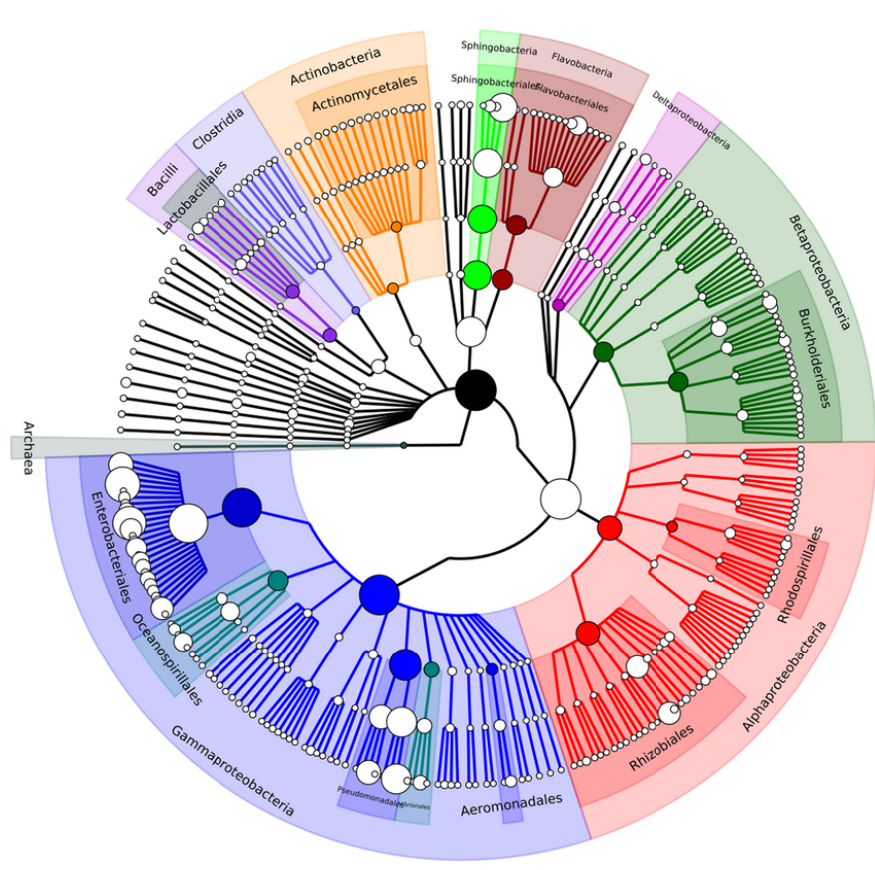
The microbiome consists of 4 important layers:
Taxonomic Layer
This layer identifies, classifies, and differentiates microorganisms in a sample.
Domain
Phylum
Class
Order
Family
Genus
Species
4
5
6
10
11
12
13
14
6
7
8

Slide 19

Genomic / Functional Layer
This layer examines genes, enzymes, and potential biological functions in the microbiome's genomic assembly.
What is being studied
Metabolic genes
Enzymes (EC numbers)
Potential metabolic pathways
Drug resistance systems
Virulence factors
4
5
6
10
11
12
13
14
15
16
7
8

Slide 20
MetaboliT Layer
Active metabolic reactions examine metabolit pathways in progress and metabolites produced or consumed.
Investigating things like
Short Chain Fatty Acids (SCFAs)
Drug Metabolites
Toxic or Protective Metabolites
4
5
6
10
11
12
13
14
15
16
17
8

Slide 21
Interaction / Ecological Layer
This layer examines:
Microbe-microbe interactions
Microbe-host interactions
Microbe-drug interactions
Competition for resources
Cross-feeding
Growth inhibition or enhancement
Immune system regulation
Production of host-affecting metabolites
Intestinal permeability
Drug activation or inactivation
Change in toxicity or effective dose
13
14
15
16
17
18
Notes:
رقابت برای منابع
تغذیه متقاطع
مهار یا افزایش رشد
فعال‌سازی یا غیرفعال‌سازی دارو
تغییر در سمیت یا دوز مؤثر
تنظیم سیستم ایمنی
تولید متابولیت‌های مؤثر بر میزبان
نفوذپذیری روده

Slide 22
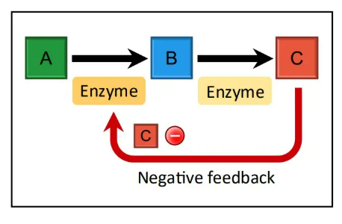
What is a Metabolic Pathway?
A metabolic pathway is an ordered sequence of biochemical reactions carried out by enzymes, during which a molecule (Substrate) is converted into new molecules (Products).
A biological production line in which at each stage an enzyme carries out a reaction and sends the molecule to the next stage to ultimately reach a specific product.
And this production line:
Has a specific goal
The reactions are precisely interrelated
It is carried out in an orderly manner in the cell or microbial environment
13
14
15
16
17
18

Slide 23
Main characteristics of metabolic pathways
Multi-step and enzyme-driven
Each step a biochemical reaction
Reaction carrier a specific enzyme
Without enzymes, the pathway becomes.
Controllable and regulated
16
17
18
19

Slide 24
Cells regulate pathways based on conditions:
Activation
Capacity
Speed ​​of reactions
Interconnected
No pathway is independent. The product of one pathway becomes the input of another.
16
17
18
19
20
22
23
24
25
26
27
28

Slide 25
Why are metabolic pathways important?
ATP ​​energy production
Production of essential molecules
Amino acids
Nucleotides
Vitamins
Detoxification and drug metabolism
Very important in the microbiome: bacteria modify drugs through reduction, hydrolysis, deamination, decarboxylation, etc.
Creating biological and functional diversity in the microbiome
18
18
19
20
20
22
23
24
25
26
27
28

Slide 26
Practical example in microbiome and drugs
Digoxin reduction pathway by Eggerthella lenta
The drug enters the intestine
The E. lenta bacteria express the cgr operon gene
The Cgr1 and Cgr2 enzymes reduce the drug
The drug is inactivated, the drug effect is reduced
This is exactly a drug metabolic pathway carried out by the microbe.
18
18
19
20
21
22
23
24
25
26
27
28
Notes:
اپرون یعنی:
چند ژن که کنار هم قرار دارند و با هم و تحت یک تنظیم مشترک بیان می‌شوند
cgr operon = یک خوشه ژنی با عملکرد مشترک

Slide 27
Tools used in computational bioinformatics
Sequence Analysis & Alignment
Used for DNA/RNA/protein comparison and annotation.
BLAST / PSI-BLAST : sequence similarity search
Clustal Omega : multiple sequence alignment
MAFFT : fast large-scale alignments
Bowtie / BWA : short-read alignment
HMMER : profile HMM-based searches
Metagenomics & Microbiome Analysis
QIIME 2 :16S & shotgun microbiome analysis
MetaPhlAn : taxonomic profiling
HUMAnN : functional profiling
Kraken2 : ultra-fast taxonomic classification
MEGAHIT : metagenome assembly
18
18
19
20
21
22
23
24
25
26
27
28

Slide 28
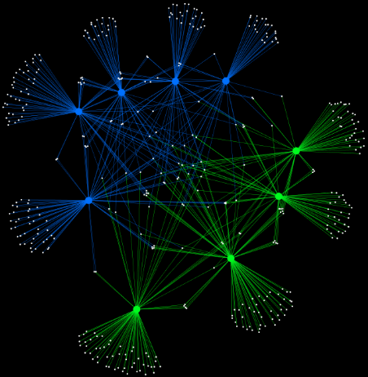
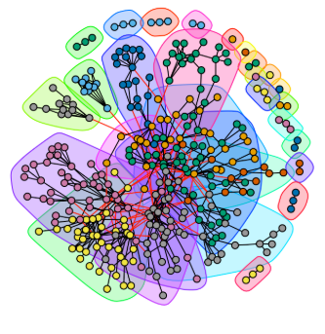


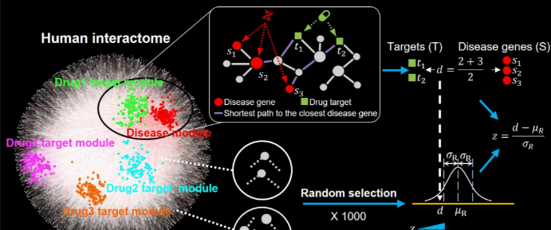

Biological Network Validation Tools
18
18
19
20
21
22
23
24
25
26
27
28

Slide 29

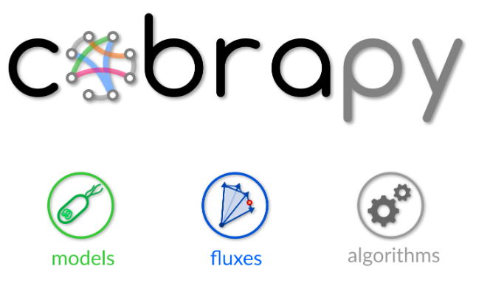


Metabolic and Systems Model Validation Tools
18
18
19
20
21
22
23
24
25
26
27
28

Slide 30




Biological Validation Tools
18
18
19
20
21
22
23
24
25
26
27
28

Slide 31
Machine Learning Model Validation Tools
TensorFlow / PyTorch
scikit-learn (Python)
CNN – Convolutional Neural Network
DNN – Deep Neural Network
CGN / GCN – Graph (Convolutional) Neural Network
Nested Cross-Validation
Cross-Validation
Calculating ROC, PR curves
ROCR and pROC
Statistical Validation Tools
Stats models
SciPy
R
18
18
19
20
21
22
23
24
25
26
27
28

Slide 32
Advantage
Predicting microbial functions
Supporting precision medicine
Reducing research costs and time
Possibility of simulation and virtual intervention
Analyzing large and complex data
18
18
19
20
21
22
23
24
25
26
27
28

Slide 33
Disadvantages
Limitations in coverage of microbial diversity
Need for interdisciplinary expertise
Strong dependence on data quality
Gap between prediction and biological reality
Lack of comprehensive standards
Over complexity of models
25
26
27
28

Slide 34
Challenge
Data Integration
Privacy & Ethics
Standardization
Computational Infrastructure
Clinical Interpretation
Lack of Multidisciplinary Workforce
Clinical Validation Challenge
27
28
29
30

Slide 35
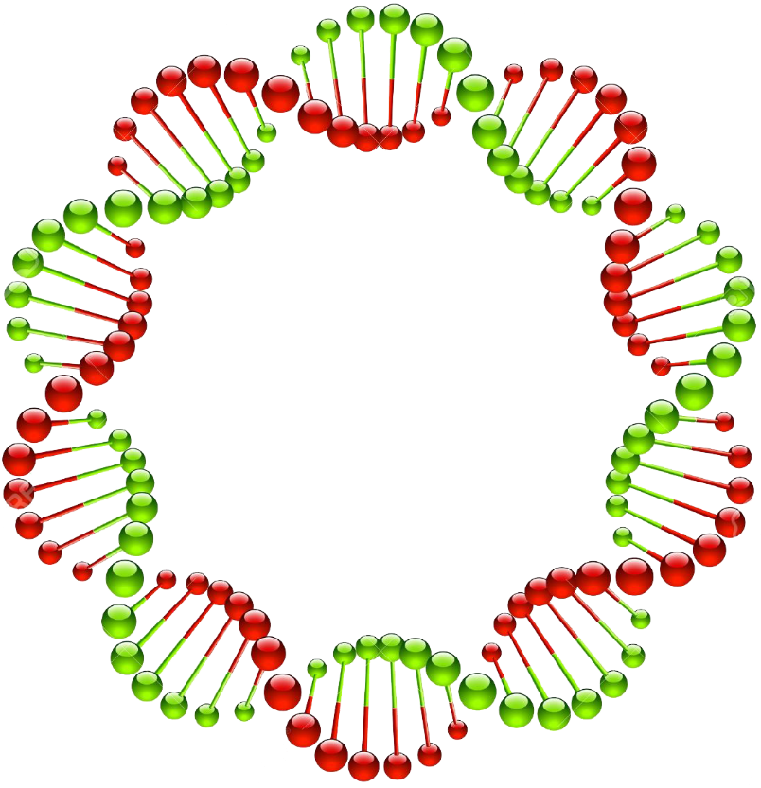
The future of computational microbiome
Computational microbiome is now a predictive, interventional, and clinically oriented science. The convergence of systems biology, machine learning, and clinical data will make this field a key pillar of future medicine and biotechnology.
Moving towards Multi-omics Integration
1
Developing predictive models based on machine learning and deep learning
2
The future of computational microbiome
The future of computational microbiome
System-based simulations and genome-based modeling
3
From Descriptive to Interventional
4
28
29
30
31

Slide 36


Slide 37
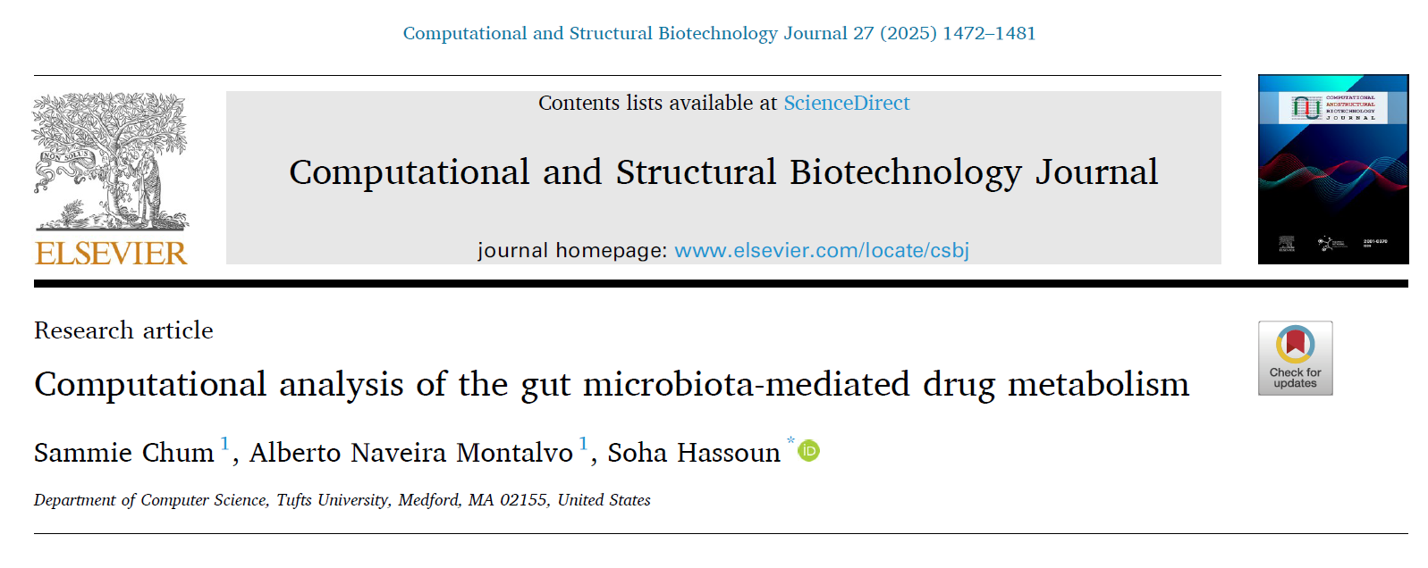
back

Slide 38
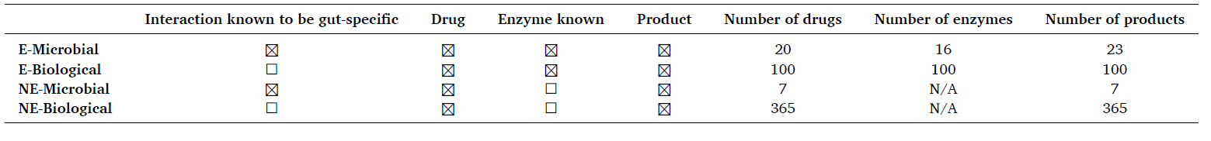
Data bases
Drug Bank
UHGG (Unified Human Gastrointestinal Genome) :for genomic information of gut microbes and enzymes.
MagMD :database of drug–microbiota interactions.
MASI : Microbiota–Active Substance Interactions.
KEGG : specifically for Enzyme Commission numbers and KEGG modules.
RetroRules : a set of biotransformation rules for predicting chemical transformations.
Notes:
پایگاه‌های داده مورد استفاده
UHGG : برای اطلاعات ژنومی میکروب‌ها و آنزیم‌های روده.
MagMD - پایگاه داده تعاملات دارو-میکروبیوتا.
MASI - تعاملات میکروبیوتا-ماده فعال
KEGG - به طور خاص برای اعداد EC کمیسیون آنزیم و ماژول‌های KEGG.
RetroRules - مجموعه‌ای از قوانین زیست‌دگرگونی برای پیش‌بینی تحولات شیمیایی.

Slide 39
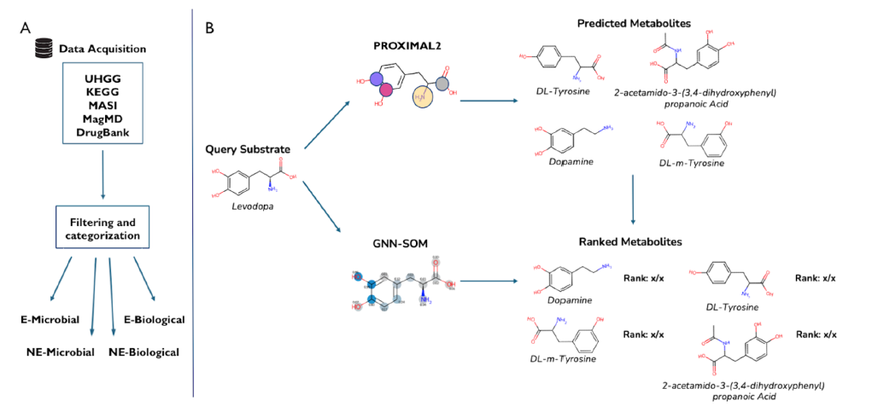

Slide 40
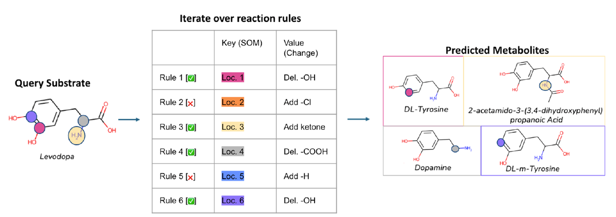

Slide 41
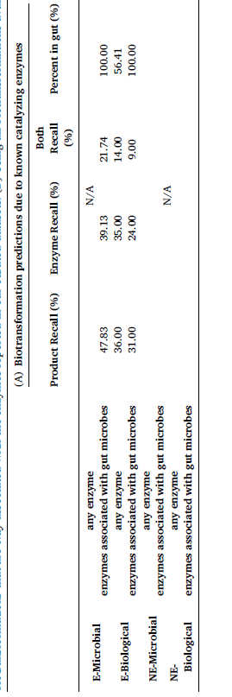
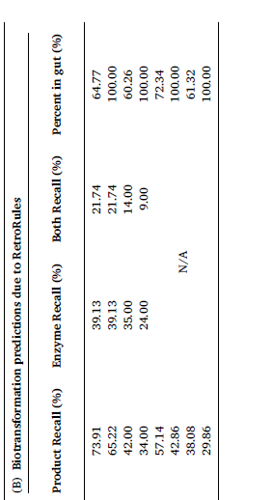
Conclusion
Notes:
با استفاده از PROXIMAL2 و گسترش مجموعه‌ی مرجع بیوترنسفورماسیون‌ها با در نظر گرفتن کل RetroRules، مدل توانست عملکرد بهتری در پیش‌بینی محصولات متابولیسم دارویی میکروبی روده (gut MDM) نشان دهد. به‌طور مثال، در مجموعه‌داده‌ی E-Microbial، میزان بازیابی محصولات از 47.83٪ با محدود کردن به آنزیم‌های مستند، به 65.22٪ رسید و این نشان‌دهنده توانایی PROXIMAL2 در پیش‌بینی محصولات حتی فراتر از آنزیم‌های مستند بود. برای داده‌هایی که به طور خاص مربوط به gut MDM نبودند، مانند E-Biological، بازیابی محصولات پایین‌تر بود و حتی با گسترش به کل RetroRules، بازیابی محصول به 34٪ کاهش یافت، زیرا قوانین بیوترنسفورماسیون به‌خوبی پوشش داده نشده بودند. همچنین، در مجموعه‌داده‌های بدون اطلاعات آنزیمی (NE-Microbial و NE-Biological)، PROXIMAL2 توانست به‌ترتیب حدود 43٪ و 30٪ از محصولات مرتبط با gut MDM را پیش‌بینی کند، نشان‌دهنده این است که این مدل حتی برای بیوترنسفورماسیون‌های ناشناخته نیز می‌تواند پیشنهادات آنزیمی مرتبط ارائه دهد. در کل، این نتایج نشان می‌دهند که PROXIMAL2 توانایی قابل توجهی در حاشیه‌نویسی محصولات و ارائه آنزیم‌های مرتبط با متابولیسم دارویی میکروبی روده دارد، حتی در مواردی که اطلاعات آنزیمی کامل نیست.

Slide 42

Limitations
Dependence on Available Databases
Lack of Gene Abundance and Expression Information
Generation of False-Positive Metabolites
Notes:
وابستگی به پایگاه‌های داده موجود
کمبود اطلاعات فراوانی و بیان ژن
تولید متابولیت‌های مثبت کاذب

Slide 43
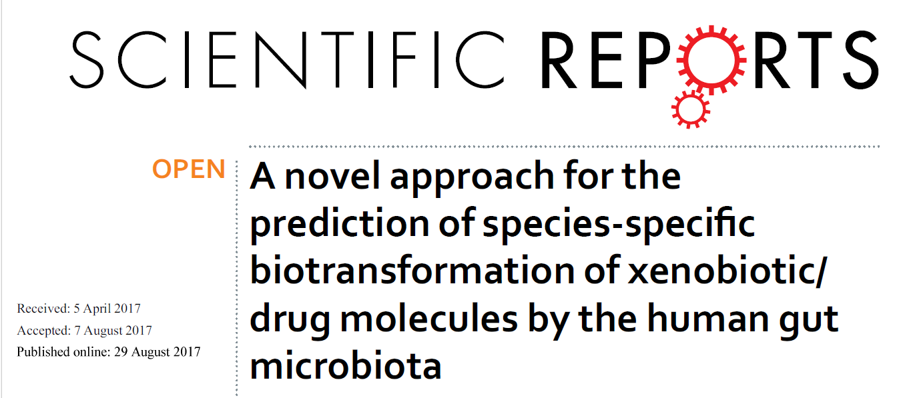
back

Slide 44
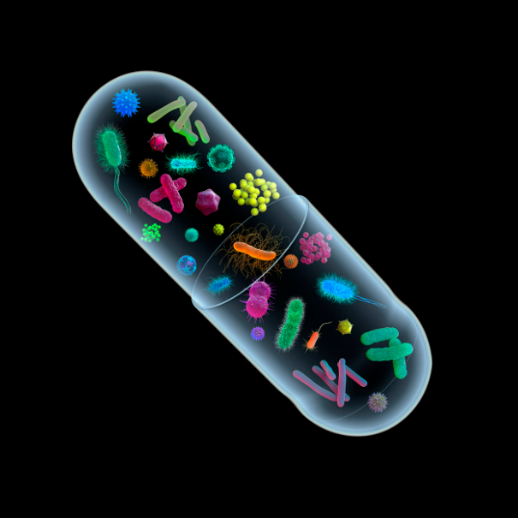
Objective
Predicting the ability of different species of human intestinal bacteria to biotransform drugs and foreign compounds
Significance:
Helping to Design More Sustainable Drugs
Predicting Drug Behavior in the Gut
A Basis for Personalized Pharmacy Studies
Notes:
کمک به طراحی داروهای پایدارتر
پیش‌بینی رفتار دارو در روده
مبانی برای مطالعات داروسازی شخصی‌سازی‌شده

Slide 45

Data collection and preparation
Drug Bank
VMH
KEGG
NCBI & UNIPORT
authoritative experimental articles

Slide 46
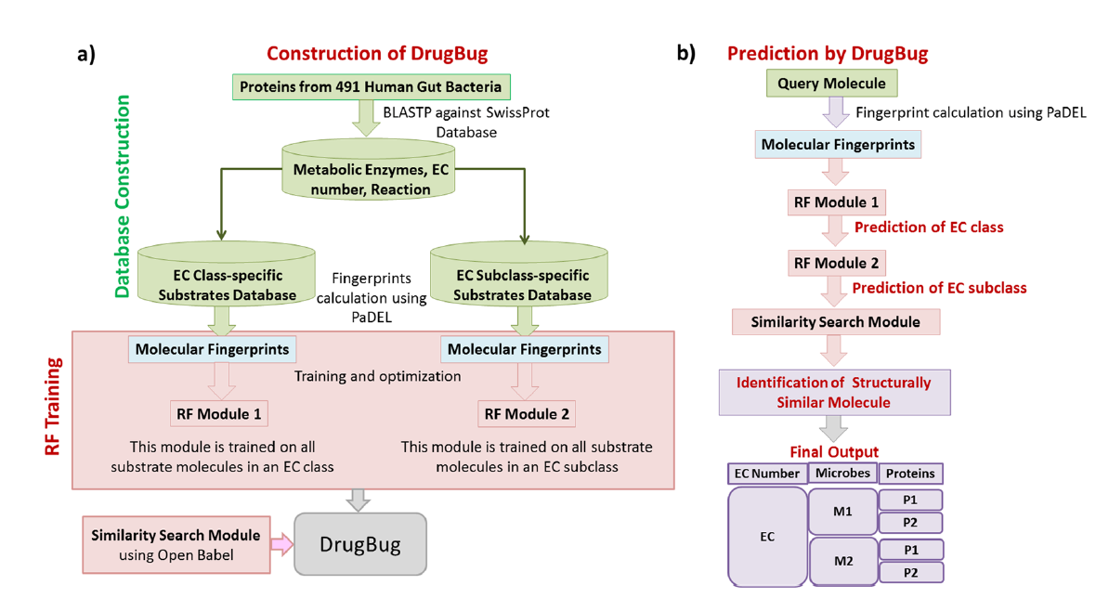

Slide 47
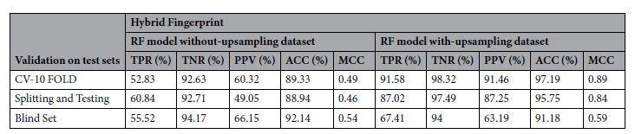
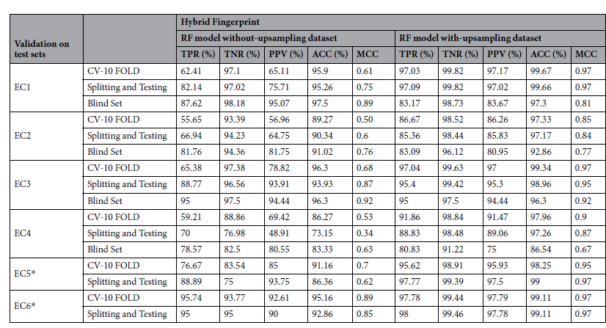
Results
cross validation 98/61
Splitting 98/52
Blind set 93.25
Notes:
توانایی مدل در تشخیص کلاس اصلی آنزیم‌ها بسیار بالا بود.
مدل توانست زیرکلاس‌های آنزیمی را با دقت قابل قبول شناسایی کند
یعنی سه چهارم پیش‌بینی‌ها به درستی آنزیم و گونه مربوطه را مشخص کرده‌اند.

Slide 48

Limited Experimental Validation
Lack of Drug-Specific Chemical Structure Consideration
Notes:
اعتبارسنجی تجربی محدود
بسیاری از واکنش‌های متابولیکی پیش‌بینی‌شده هنوز به صورت تجربی اعتبارسنجی نشده‌اند.
عدم بررسی ساختار شیمیایی خاص دارو

Slide 49
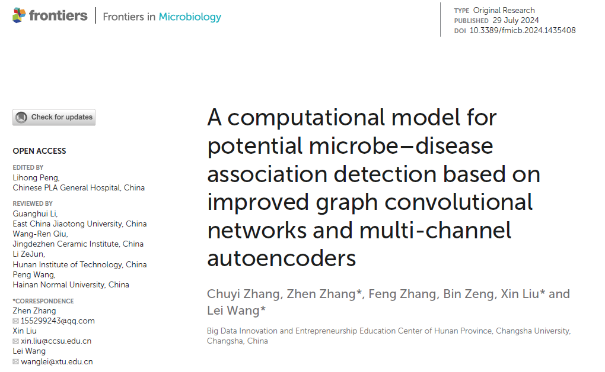
back

Slide 50
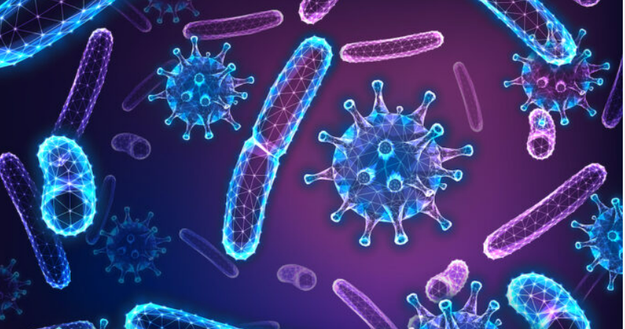
Objective
To present a new computational model called GCANCAE to identify the possibility of potential associations between microbes and diseases. The idea is to combine network topological features and microbe/disease attributes to predict unknown associations.
Databases
The baseline databases used for testing and evaluation include the following well-known ones:
HMDAD (Human Microbe–Disease Association Database).(292 MICROBE /39 DISEASE /450 INTERACTION)
Disbiome (1052 MICROBE/218 DISEASE/4351INTERACTION)

Slide 51

How inputs were constructed: For each node (microbe or disease), two types of information were constructed:
Known network of relationships: adjacency matrix of reported associations between microbes and diseases;
Similarities/attributes: disease similarity and microbe similarity matrices extracted and normalized from functional/descriptive data.
A heterogeneous network was then constructed that combines these three types of information (known associations, disease similarity, microbe similarity) to become the model input.

Slide 52
Method

Slide 53
Conclusion
GCANCAE performed better or at least as well as competing methods in comparative tests (2-fold and 5-fold CV), meaning that the model was more capable of identifying potential microbe–disease associations.
Case studies on asthma, IBS, and type 2 diabetes demonstrated that the model’s predictions were consistent with the literature evidence (i.e., the model provided plausible biological candidates).
Main advantage: Separating the extraction of topological features (with GCAN) and trait features (with CSAE) separately and then merging the results increased the representation power and prediction accuracy.

Slide 54
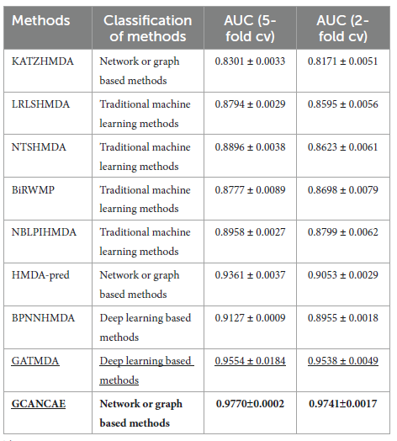
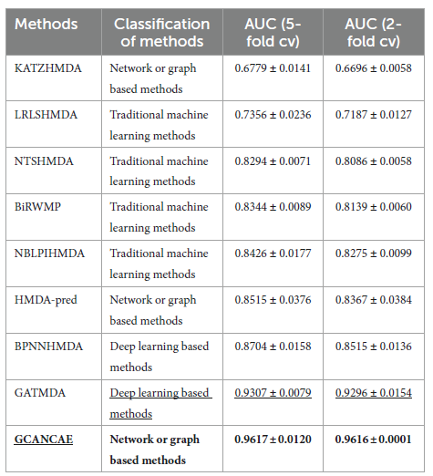
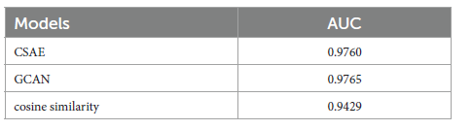
Notes:
با بررسی جدول ۴ مشاهده کردیم که GCANCAE زمانی که هر دو مؤلفه GCAN و CSAE را به‌طور هم‌زمان به‌کار می‌گیرد، عملکرد پیش‌بینی بهتری نسبت به حالتی دارد که فقط یکی از آن‌ها (GCAN یا CSAE) استفاده شود. علاوه بر این، ادغام GCAN و CSAE با معیار شباهت کسینوسی نیز باعث بهبود بیشتر عملکرد پیش‌بینی GCANCAE می‌شود

Slide 55
Limitations
There is limited experimental evidence for some microbe–disease pairs.
Computational Cost of Convolutional Channels (CSAE)
Notes:
Computational Cost of Convolutional Channels
استفاده از کانال‌های کانولوشنال چندگانه در مدل (CSAE) پردازش‌طلب و زمان‌بر است. این موضوع می‌تواند در مقیاس‌گذاری مدل برای مجموعه‌های داده بسیار بزرگ چالش ایجاد کند
Biological Interpretability
اگرچه مدل عملکرد پیش‌بینی قوی دارد، تبیین زیستی دقیقِ چگونگی ارتباطِ پیش‌بینی‌شده بین میکروب و بیماری در بسیاری از موارد هنوز نامشخص است — به‌ویژه در بیماری‌هایی با مسیرهای پیچیده چندعاملی.
Dependency on Baseline Databases
مدل به دو پایگاه داده مرجع یعنی HMDAD و Disbiome متکی است. این‌ها منابع مهم‌اند اما پوشش آن‌ها نسبت به تنوع واقعی میکروبیوم انسان و بیماری‌ها هنوز کامل نیست.
Lack of Host Context Integration
مدل فقط روی شبکه میکروب–بیماری تمرکز دارد و جنبه‌هایی مانند اثر ژنوم میزبان انسان، سیستم ایمنی، یا محیط روده در روابط بیماری لحاظ نشده‌اند.

Slide 56
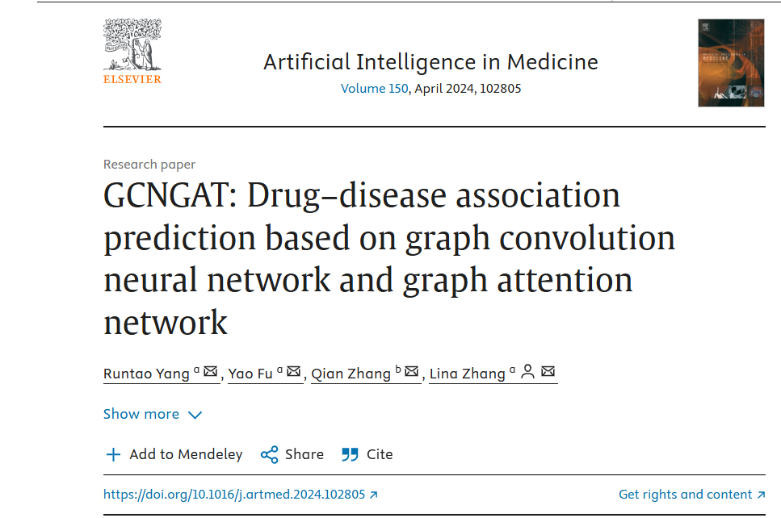
back

Slide 57
Article Type
This article is an original research paper in the field of drug–disease association prediction using deep learning methods and neural graph networks.
Purpose : To develop a computational model to predict possible associations between drugs and diseases in order to discover new uses for drugs
Databases
Two reference datasets were used to evaluate the model:
PREDICT dataset
Another dataset called CDataset

Slide 58

Method
Build a heterogeneous graph of existing drug-disease relationships.
For each drug-disease pair, extract the corresponding subgraph to separate different contexts for the same drug for different diseases.
Apply a combination of graph neural networks: both Graph Convolutional Network (GCN) and Graph Attention Network (GAT) — GCN to extract global structural features, GAT to learn local/neighborhood features with different weights for neighbors.
Use a model called GnnAp (graph neural network + global average pooling + prediction module) to generate feature vectors (embedding) for drug-disease and predict the probability of association.

Slide 59
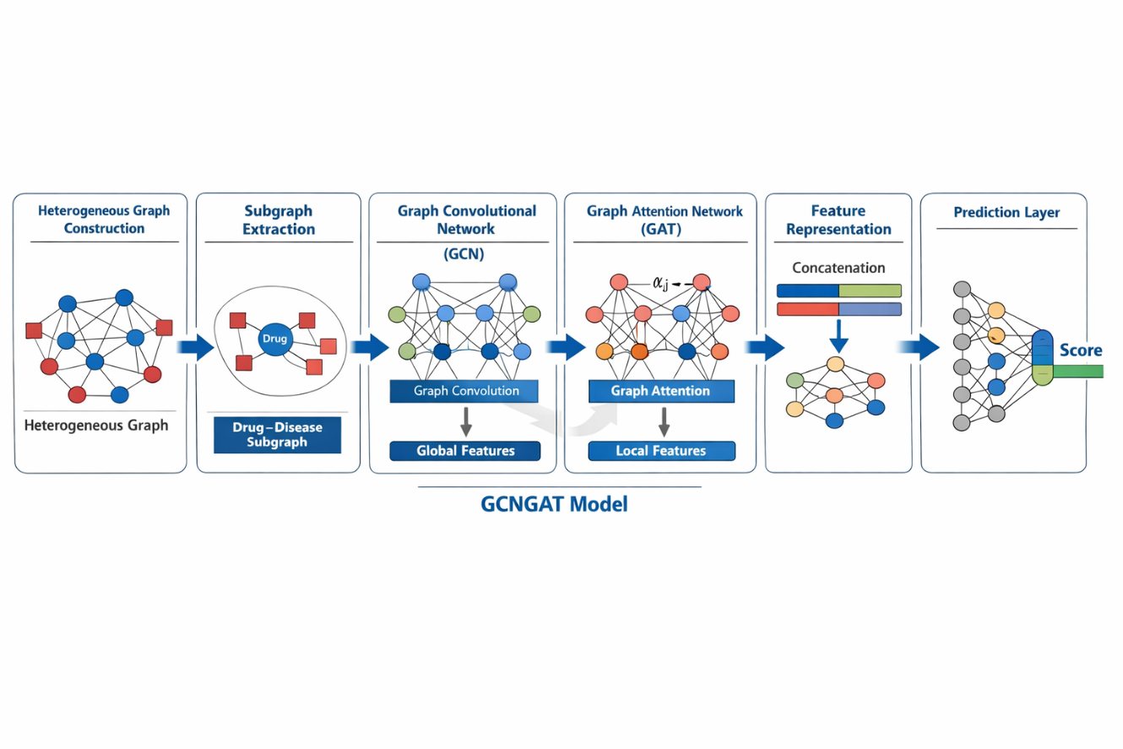
Notes:
ترکیبی از GCN + GAT + استخراج زیرگراف + ادغام جهانی :
یعنی در واقع، یک مدل گراف عصبی ترکیبی که هم لایه‌های کانولوشنی (GCN) و هم لایه‌های مبتنی بر توجه (GAT) دارد و برای هر جفت دارو-بیماری یک زیرگراف مستقل ایجاد می‌کند و یک جاسازی از آن استخراج می‌کند.
مدل نهایی: "GCNGAT" که شامل یک ماژول یادگیری گراف + یک ماژول پیش‌بینی GnnAp است.

Slide 60
Results
For the PREDICT dataset, the model achieved AUC = 0.9182 with a 5-fold CV.
For the CDataset dataset, AUC = 0.9417 is reported.
Compared to the previous best competing model (on the same dataset) — PSGCN — GCNGAT has an AUC increase of about 1.58%.
Extracting a subgraph for each drug-disease pair (instead of using a global graph) allows the model to consider a different context for each pair, which is a significant improvement in performance.
Combining GCN and GAT allows both global/structural features and local/neighborhood interactions to be learned accurately.
Notes:
استخراج یک زیرگراف برای هر جفت دارو-بیماری (به جای استفاده از یک نمودار سراسری) به مدل اجازه می‌دهد تا زمینه متفاوتی را برای هر جفت در نظر بگیرد، که بهبود قابل توجهی در عملکرد است.
ترکیب GCN و GAT امکان یادگیری دقیق ویژگی‌های سراسری/ساختاری و تعاملات محلی/همسایگی را فراهم می‌کند.
کاربرد بالقوه: این مدل می‌تواند به عنوان ابزاری برای تغییر موقعیت دارو - یعنی پیشنهاد کاربردهای جدید دارو برای بیماری‌های مختلف - مورد استفاده قرار گیرد.

Slide 61
Limitations
The model is dependent on the quality of input data and datasets.
Any errors or biases in the data can directly affect prediction reliability and accuracy
Notes:
محدودیت‌هااین مدل به کیفیت داده‌های ورودی و مجموعه داده‌ها وابسته است.
هرگونه خطا یا سوگیری در داده‌ها می‌تواند مستقیماً بر قابلیت اطمینان و دقت پیش‌بینی تأثیر بگذارد.

Slide 62
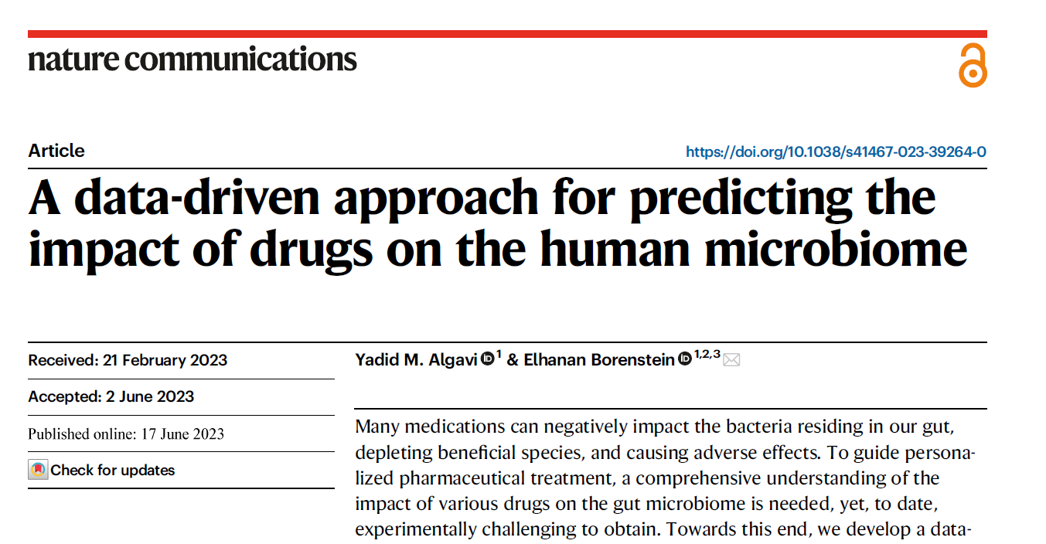
back
Notes:
یک چارچوب داده‌محور ساختن تا بتواند اثر داروها روی باکتری‌های روده‌ای انسان را پیش‌بینی کند، چون اندازه‌گیری تجربی این اثرات برای هر داروی ممکن بسیار دشوار و زمان‌بر است.

Slide 63
Input data
1. In vitro data
• A set of 40 bacterial strains that were tested for their growth in the presence of different drugs.
• For each drug-bacteria pair, the result of growth inhibition or no effect was recorded (classified as “0 = no effect” or “1 = growth inhibition”).
2. Drug properties
For each drug, properties were extracted from its chemical structure (formula, SMILES, and physicochemical properties). These are the inputs to the learning model.
3. Bacterial properties
For each bacterial species, data from genes and biochemical pathways were extracted that represent the metabolic and structural capabilities of that bacterium (genomic information).

Slide 64
Public Databases for Feature Extraction
Drug Bank: Contains information on approximately 2,585 clinically approved small-molecule drugs along with their chemical properties.
Genomic Databases – KEGG / IMG GOLD / NCBI: Genomic data were used to describe microbial species, particularly KEGG pathways, which indicate their biochemical capabilities.
Metagenomics Data: Sequencing data from healthy populations representing 409 diverse gut microbial species.
SIDER: Provides information on drug side effects

Slide 65
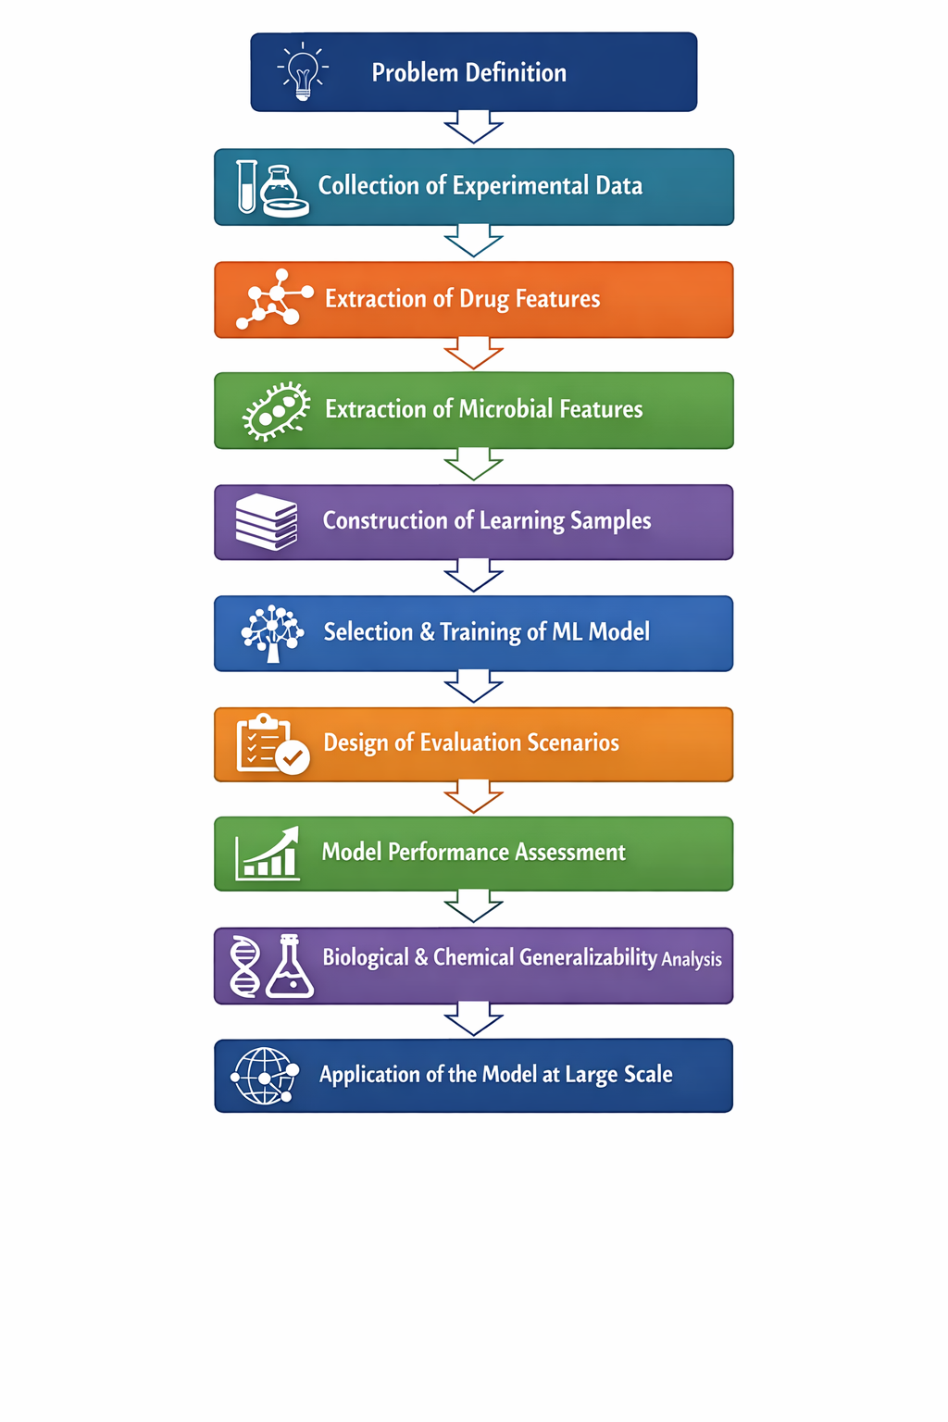
Methodology
The study extracts in vitro experimental data, chemical features of drugs, and genomic–metabolic features of microbes, and integrates them into a Random Forest model to predict drug–microbe interactions as a binary classification problem.
The model’s generalizability to new drugs and microbes is evaluated through realistic assessment scenarios, and finally, the model is applied to large-scale prediction of drug effects across diverse microbial species.

Slide 67
Validation Results
Model performance was measured using ROC AUC and PR AUC. Additional analyses included the impact of chemical similarity between drugs and phylogenetic distance among microbes, as well as the effect of removing an entire phylogenetic branch.
The model achieved high overall performance: ROC AUC ≈ 0.97, PR AUC ≈ 0.9.
Best performance was observed for new interactions, while performance decreased for completely new drugs and phylogenetically distant microbes.
Notes:
عملکرد مدل با ROC AUC و PR AUC اندازه‌گیری شد و تحلیل‌های تکمیلی شامل تأثیر شباهت شیمیایی داروها و فاصله فیلوژنتیکی میکروب‌ها بود. همچنین اثر حذف کامل یک شاخه فیلوژنتیکی بررسی شد.
نتایج کلیدی:
مدل عملکرد بسیار بالایی دارد ROC AUC ≈ 0.97, PR AUC ≈ 0.9.
بهترین عملکرد برای تعامل‌های جدید و کاهش عملکرد برای داروهای کاملاً جدید و میکروب‌های دور فیلوژنتیکی مشاهده شد.
شباهت شیمیایی داروها و نزدیکی فیلوژنتیکی میکروب‌ها نقش کلیدی در دقت مدل دارند.
مدل حتی با داده‌های in vivo هم هم‌راستایی خوبی نشان می‌دهد.
مدل دقیق و تعمیم‌پذیر است، اما پیش‌بینی داروها یا میکروب‌های کاملاً جدید کمی چالش‌برانگیز است.

Slide 68
Limitations
Actual Site of Drug Action
Intra-Species (Strain) Diversity
Notes:
محدودیت‌ها
محل واقعی اثر دارو
این مدل از داده‌های آزمایشگاهی با غلظت‌های ثابت دارو استفاده می‌کند که دقیقاً منعکس‌کننده غلظت‌های واقعی دارو در روده نیستند. این ممکن است منجر به عدم دقت برای داروهای خاص شود.
تنوع درون گونه‌ای (سویه)
فقط از یک سویه نماینده برای هر گونه باکتریایی استفاده شد، در حالی که برخی از سویه‌ها ممکن است به داروها پاسخ متفاوتی دهند.
ساختار مدل ساده‌شده
این مدل به ویژگی‌های ساده متکی است و عوامل پویای پیچیده در روده، مانند تعاملات میکروب-میزبان یا متابولیسم داروی میزبان را در نظر نمی‌گیرد.

Slide 69

Waqas, A., Tripathi, A., et al. (2024). Multimodal Data Integration for Oncology in the Era of Deep Neural Networks. Frontiers in Artificial Intelligence.Anjum, A., & Subhani, M. M. (2019).
Multiclass Disease Predictions Based on Integrated Clinical and Genomics Datasets. ­IARIA Conference Paper.
Dukovski, et al. “A metabolic modeling platform for the computation of microbial ecosystems in time and space (COMETS).” Nature Protocols, 2021.
Mendes, P., Hoops, S., Sahle, S., Gauges, R., Dada, J., & Kummer, U. “Computational modeling of biochemical networks using COPASI.” Methods in Molecular Biology, 2009.
Jung, S. “Advances in functional analysis of the microbiome.” Journal of Microbiology, 2025.
Hunik, R.,. “Diagnostic Prediction Models for Primary Care, Based on AI and Electronic Health Records: Systematic Review.” JMIR Medical Informatics, 2025.
Wang, T., Zhang, X., Wang, Y., & Peng, J. (2025). Recent Progress and Challenges of Artificial Intelligence in Bioinformatics and New Medicine. Applied Sciences.
Field, M. A. (2022). Bioinformatic Challenges Detecting Genetic Variation in Precision Medicine Programs. Frontiers in Medicine.
Kwak, G. H. & Hui, P. (2019). DeepHealth: Review and challenges of artificial intelligence in health informatics.
Wang, T., Zhang, X., Wang, Y., & Peng, J. «Recent Progress and Challenges of Artificial Intelligence in Bioinformatics and New Medicine». Applied Sciences, 2025.

Slide 70
11.Valenzuela, O., Cannataro, M., Rusur, I., et al. «Advances and challenges in Bioinformatics and Biomedical Engineering: IWBBIO 2020». BMC Bioinformatics, 2023.
12. MICOM: Metagenome-Scale Modeling To Infer Metabolic Interactions in the Gut Microbiota
13. EcoFABs: advancing microbiome science through standardized fabricated ecosystems Microbiome data science:the challenge of ntegration.
14. Introduction to bioinformatics: Past, present and future On the role of bioinformatics and data science in industrial microbiome applications
15. A brief history of bioinformatics J Gauthier, AT Vincent, SJ Charette… - … in bioinformatics, 2019 - academic.oup.com
16. Challenges in Bioinformatics Workflows for Processing Microbiome Omics Data at Scale. https://doi.org/10.3389/fbinf.2021.826370
17. Human Microbiome Acquisition and Bioinformatic Challenges in Metagenomic Studies. https://doi.org/10.3390/ijms19020383
18. Computational approaches for integrative analysis of the metabolome and microbiome. https://doi.org/10.3390/metabo7040062
19. Advances in functional analysis of the microbiome: Integrating metabolic modeling, metabolite prediction, and pathway inference with Next-Generation … DOI: https://doi.org/10.71150/jm.2411006

Slide 71
Go to intro Introduction
Go to article 1
Go to article2
Go to article3
Thank you for your attention
Any questions?
Go to article4
Go to article5
Student’s Research committee of Yazd University of Medical sciences

